Slide 1
Data Structure and Algorithm
Course code: cs-201
Topic: Trees in data structure
Instructor: habiba arshad

Slide 2
Goals for today
Representation of Binary Tree
Binary Tree Traversal
Expression Trees

Slide 3
CLO Covered
CLO1: Explain the fundamentals of data structure as well as algorithms that operate on them GA2, BT C2
CLO2: Apply and design various data structures methods for specified applications. GA4, C3

Slide 4
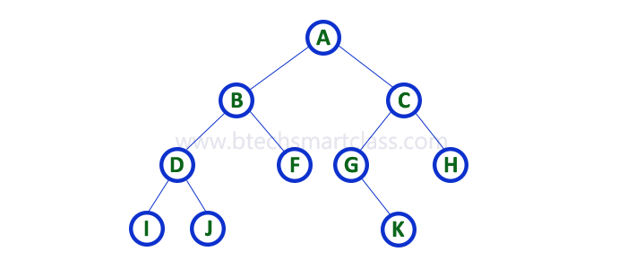
Representation of Binary Tree
A binary tree data structure is represented using two methods. Those methods are as follows...
Array Representation
Linked List Representation
Consider the following binary tree...

Slide 5

Representation of Binary Tree
Array Representation
In array representation of a binary tree, we use one-dimensional array (1-D Array) to represent a binary tree.

Slide 6
Representation Of Binary Trees
Array Representation
1
a
2
b
4
5
c
d
10
e
f
11
1 | 2 | 3 | 4 | 5 | 6 | 7 | 8 | 9 | 10 | 11
a | b |  | c | d |  |  |  |  | e | f

Slide 7
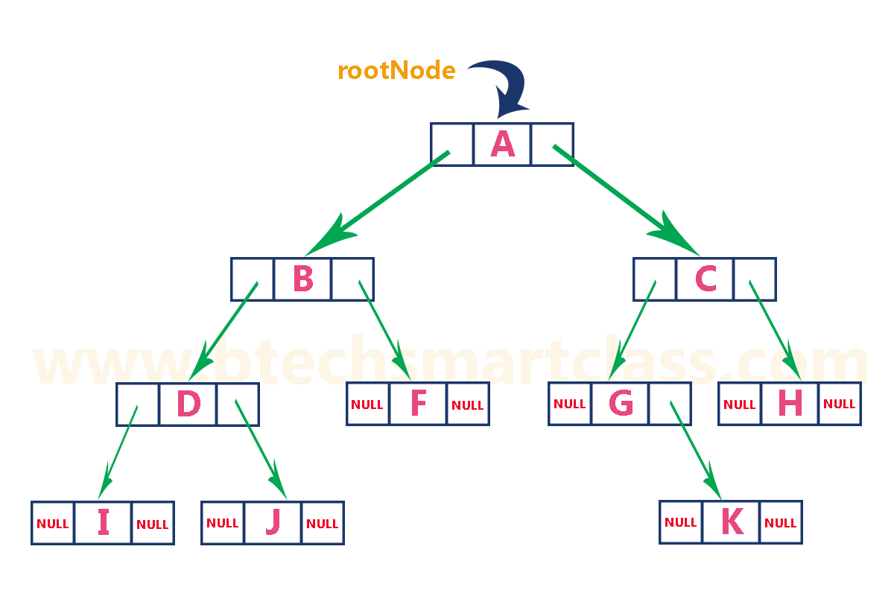

Representation of Binary Tree
2. Linked List Representation
We use a double linked list to represent a binary tree.
In a double linked list, every node consists of three fields.
First field for storing left child address,
Second for storing actual data
Third for storing right child address.

Slide 8
Binary Tree Traversal

Slide 9
Traversing in Binary Tree
In tree creation, we take three parameters Node (N), Left child (L), Right Child (R), so traversing of binary tree means traversing of node, left subtree and right subtree.
“Displaying (or) visiting order of nodes in a binary tree is
called as Binary Tree Traversal.”
When we wanted to display a binary tree, we need to follow some order in which all the nodes of that binary tree must be displayed.
In any binary tree, out of six combinations of traversals, only three are standard, NLR(node-left-right), LNR(left-node-right) and LRN(left-right-node) traversal.
Left subtree must be traversed before right subtree.

Slide 10
Traversing in Binary Tree
There are three types of binary tree traversals.
In - Order Traversal (LNR Traversal)
Pre - Order Traversal (NLR Traversal)
Post - Order Traversal (LRN Traversal)
Root
Left
Right
Notes:
https://youtu.be/XRcC7bAtL3c
https://youtu.be/-b2lciNd2L4

Slide 11
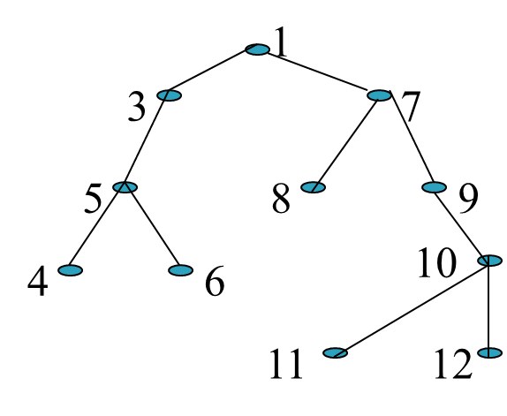
In - Order Traversal (LNR Traversal)
First, visit all the nodes in the left subtree
Then the root node
Visit all the nodes in the right subtree
Inorder:
4 5 6 3 1 8 7 9 11 10 12

Slide 12
Pre - Order Traversal (NLR Traversal)
Visit root node
Visit all the nodes in the left subtree
Visit all the nodes in the right subtree
Preorder:
1 3 5 4 6 7 8 9 10 11 12

Slide 13
Post - Order Traversal (LRN Traversal)
Visit all the nodes in the left subtree
Visit all the nodes in the right subtree
Visit the root node
Postorder:
4 6 5 3 8 11 12 10 9 7 1

Slide 14
Traversing in Binary Tree
Let’s take a binary tree and apply each traversal.
In-order traversal (LNR)
I - D - J - B - F - A - G - K - C – H
Pre-order traversal (NLR)
A - B - D - I - J - F - C - G - K – H
Post-order traversal (LRN)
I - J - D - F - B - K - G - H - C - A

Slide 15
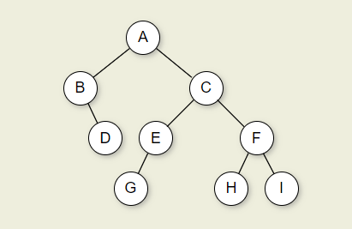
Task
Find the preorder, postorder and inorder traversals of following tree:
Also form the tree again from preorder and postorder traversals
Notes:
1- Pre order (NLR)
2-In order (LNR)
3- Post order (LRN)

